Slide 1


HDLC in Computer Networks
The Layer 2 Protocol of the TCP/IP Model

Slide 2
What is HDLC?
High-Level Data Link Control (HDLC)
ISO Standard Foundation
Core Functionality
Developed as an international standard (ISO/IEC 13239:2002), HDLC traces its roots to IBM's Synchronous Data Link Control (SDLC) protocol, inheriting its robust design principles.
It is extensively utilized in Wide Area Network (WAN) connectivity to provide essential services such as data framing, comprehensive error detection, and efficient flow control mechanisms.
HDLC is a fundamental Layer 2 (Data Link Layer) protocol crucial for reliable data transfer over both point-to-point and multipoint communication links.

Slide 3
HDLC’s Role in the TCP/IP Model
1
Data Link Layer Operation
2
Framing Network Packets
3
Ensuring Link Reliability
HDLC guarantees reliable communication by implementing robust error detection and sophisticated flow control mechanisms, ensuring data integrity and preventing network congestion between directly connected devices.
HDLC operates exclusively at the Data Link Layer (Layer 2) of the TCP/IP model, positioned directly above the Physical Layer. This strategic placement allows it to manage the physical transmission medium.
Its primary responsibility includes taking raw data packets from the Network Layer (Layer 3) and encapsulating them into structured frames, preparing them for physical transmission across the network.

Slide 4





Standard HDLC Frame Structure
Flag Field
An 8-bit unique pattern (01111110) that signals the beginning and end of each frame, providing clear
boundary markers.
Address Field
This field identifies the specific secondary station or device that the frame is intended for, crucial in
multipoint configurations.
Control Field
A dynamic field that manages flow control, sequence numbering, and error recovery. It dictates the type of frame (information, supervisory, unnumbered) and carries commands/responses.
Information Field
This field carries the actual payload data from the Network Layer. It is optional, particularly in certain control frames used for link management.
Frame Check Sequence (FCS)
A Cyclic Redundancy Check (CRC) field, typically 16 or 32 bits, used by the receiver to detect transmission errors and ensure data integrity.

Slide 5
How HDLC Frames Work: Bit Stuffing & Framing
Bit Stuffing for Data Transparency
Clear Frame Delineation
HDLC employs a technique called "bit stuffing" to prevent the unique flag pattern (01111110) from accidentally appearing within the data (information field). After five consecutive '1' bits in the data stream, a '0' bit is automatically inserted by the sender.
The consistent use of flag bytes at both the start and end of each HDLC frame provides robust frame boundaries. This clear identification allows for reliable synchronous and asynchronous transmission, ensuring the receiver can accurately determine where one frame ends and the next begins, even if some data is lost or corrupted.
The receiver, upon detecting five consecutive '1's followed by a '0', knows to remove the stuffed '0' bit, thereby restoring the original data transparently.

Slide 6

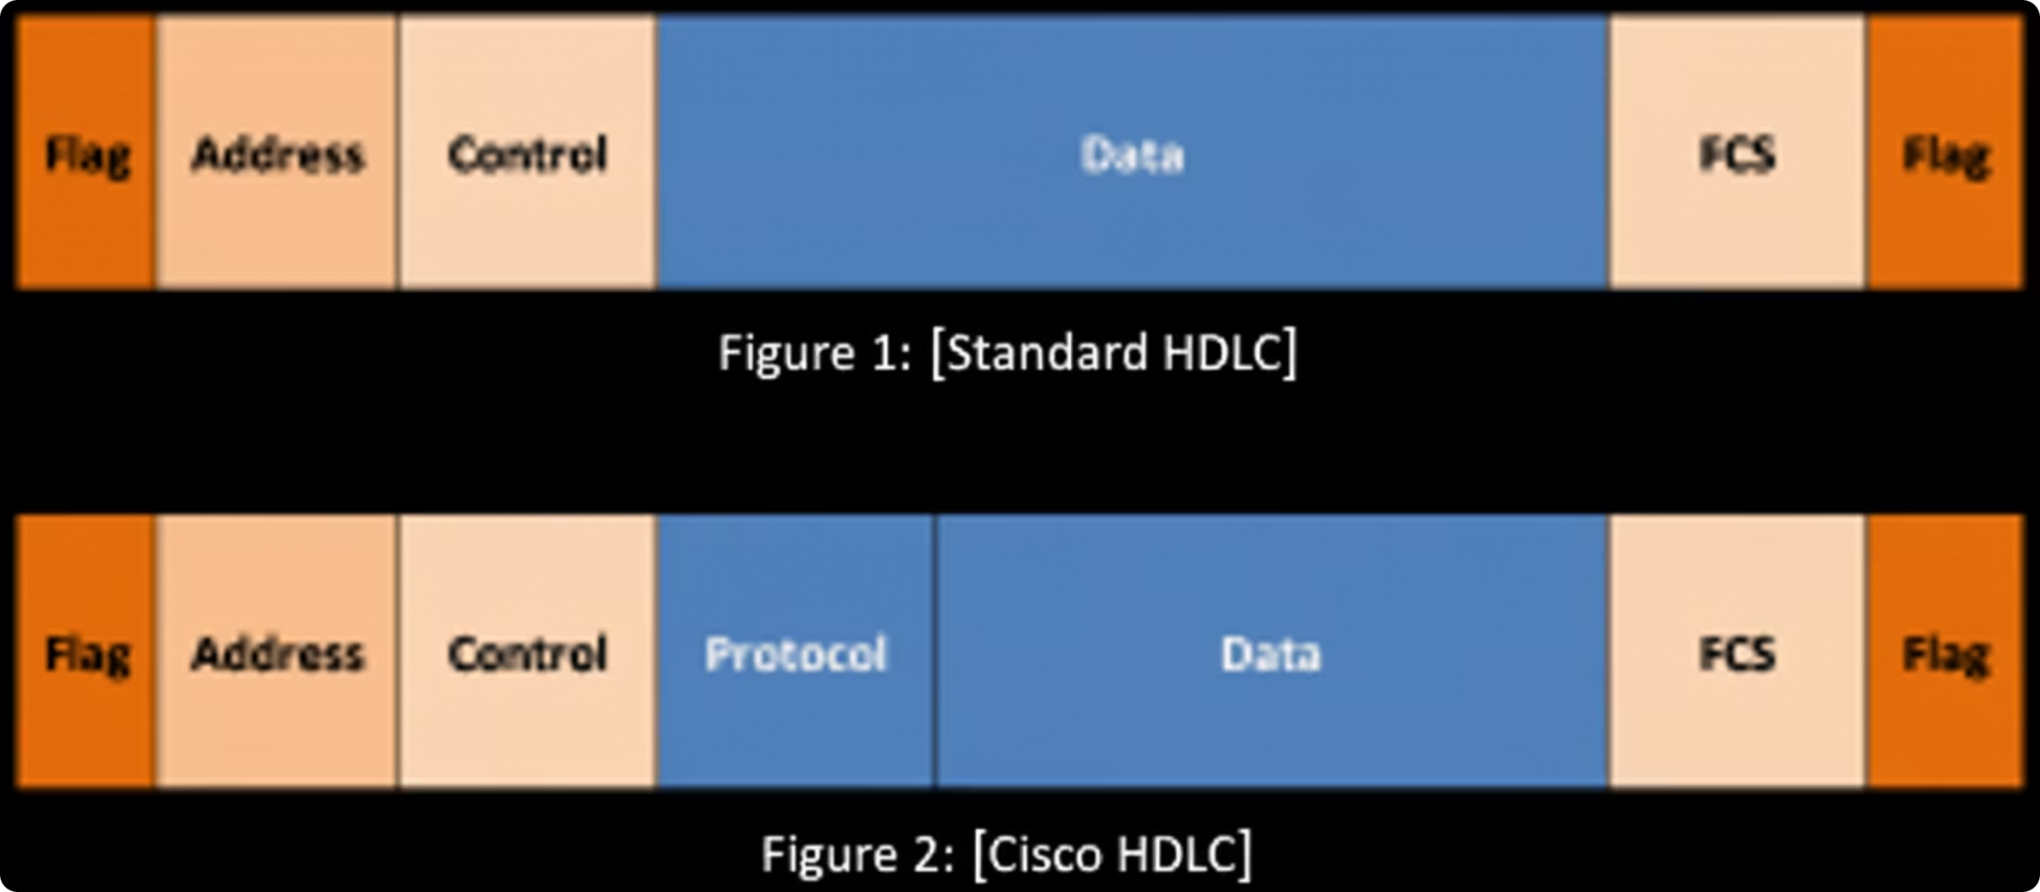
Cisco HDLC vs Standard HDLC
1
2
Cisco HDLC (cHDLC)
Standard HDLC
A proprietary extension that includes a crucial 2-byte Protocol field. This field allows cHDLC to multiplex multiple network layer protocols (e.g., IP, IPX) over a single serial link.
Lacks the Protocol field, meaning it can only support a single network layer protocol per link. This limitation makes it less flexible in multi-protocol environments.

Slide 7
HDLC Keepalives & Link Monitoring
Maintaining Link Integrity
Diagnostic Tools
Cisco HDLC utilizes keepalive packets, typically sent from the Data Communications Equipment (DCE) to the Data Terminal Equipment (DTE), to continuously verify the operational status of the serial link. These small packets include sequence numbers.
Network engineers rely on specific Cisco IOS commands to monitor HDLC link status:
show interfaces serial [interface-number]: Provides detailed interface status, including encapsulation type, link status, and keepalive information.
If the DTE fails to receive three consecutive keepalives, the link is automatically declared "down," prompting the interface to cease transmission and alert network administrators.
debug serial interface: Offers real-time insights into keepalive exchanges and other low-level events on the serial interface, invaluable for troubleshooting.

Slide 8
HDLC vs PPP: Key Differences
HDLC
PPP
Standardization
Simple, basic framing protocol. Cisco HDLC is proprietary.
Industry-standard, widely adopted and interoperable.
Authentication
No built-in authentication mechanisms.
Supports robust authentication protocols like PAP (Password Authentication Protocol) and CHAP (Challenge Handshake Authentication Protocol).
Multi-Protocol Support
Standard HDLC supports only one protocol; Cisco HDLC adds proprietary support.
Includes a Protocol field enabling multiple network layer protocols over a single link.
Error Recovery
Basic error detection via FCS.
Enhanced error detection and sophisticated error recovery mechanisms.

Slide 9
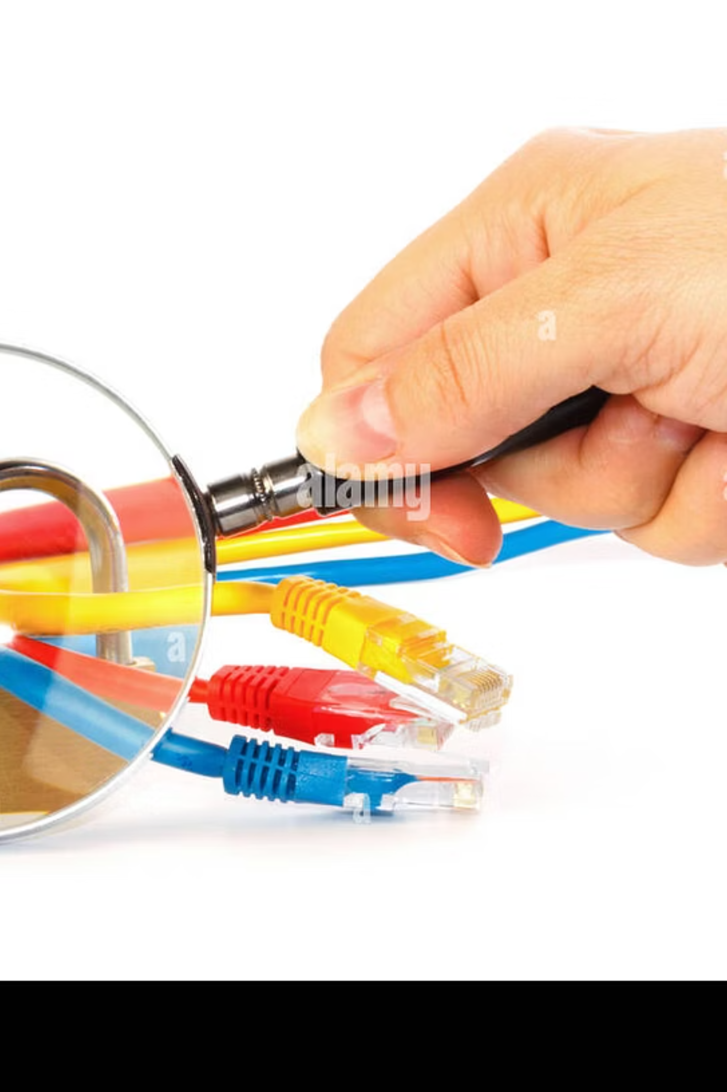




Common HDLC Troubleshooting Tips
Encapsulation Mismatch
Ensure both ends of the serial link are configured with the same encapsulation type (e.g., both Cisco HDLC or both PPP). A mismatch is a common cause of link failure.
Physical Layer Verification
Thoroughly inspect physical connections: check cables, CSU/DSU status, and ensure interface lights are green. A physical layer issue will prevent any Layer 2 protocol from functioning.
Utilize Diagnostic Commands
Leverage show interfaces (for status), show controllers (for hardware details), and debug commands (for real-time events) to pinpoint issues.
Cisco HDLC Specifics
Always remember that Cisco HDLC is proprietary and will only establish a functional link when connecting two Cisco devices. For non-Cisco connections, PPP is required.

Slide 10
Summary: Why HDLC Matters
01
02
Foundational Layer 2 Protocol
Ensuring Data Integrity
HDLC serves as a cornerstone Layer 2 protocol, vital for establishing and managing Wide Area Network (WAN) links within TCP/IP networks, particularly in traditional serial connections.
It provides fundamental services like robust data framing, efficient error detection through FCS, and crucial flow control mechanisms, all essential for reliable communication.
03
04
Cisco HDLC's Role
Essential for Network Professionals
While Standard HDLC is basic, Cisco HDLC introduces multi-protocol support but highlights the importance of understanding proprietary extensions and their interoperability implications.
A solid grasp of HDLC's principles, frame structure, and operational nuances is indispensable for network engineers involved in configuring, managing, and troubleshooting serial WAN connections.

